Slide 1

Clinical Sample Dataset Simplification, Exploratory Data Analysis, Dataset Normalization, Merging the Datasets - AML Dataset
For Survival Analysis
Ayca Öztürk

Slide 2
Proposed AML Pipeline (first survival, then digital twins)
Missing value analysis
Remove unusable features
Train/Validation/Test/ split (70-20-10)
MICE/data imputation
Clinical sample dataset simplification (one sample per patient)
Exploratory Data analysis (EDA) (relationships, patterns, errors, imbalance, unusual values etc.)
Variable normalization for the survival models
Merging the datasets (clinical patient+clinical sample) by Patient IDs. The final datasets: a) clinical-only b) genomic-only c)combined
Feature selection (which variables are included in the model?)
Survival models (from baseline to more advanced)
cox ph model
random survival forest
deepsurv
Model evaluation & Model comparison & Fine-Tuning
Model expainability
Patient digital twin generation
Treatment simulation/Personalized survival prediction

Slide 3
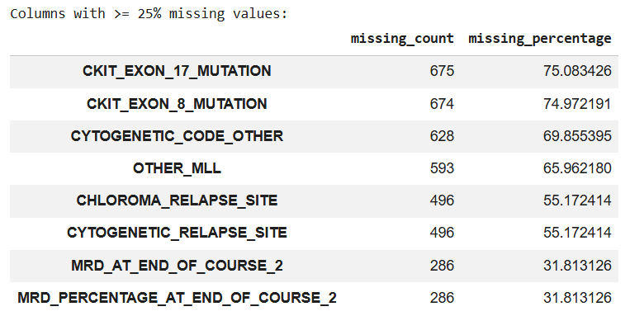
Highest missing features: Clinical Patient (>=25%)
These columns were excluded before the data imputation step

Slide 4
Other Columns that have been excluded
CR_STATUS_AT_END_OF_COURSE_1 →post treatment response
CR_STATUS_AT_END_OF_COURSE_2 →post treatment response
MRD_AT_END_OF_COURSE_1 →post treatment response
MRD_PERCENTAGE_AT_END_OF_COURSE_1 →post treatment response
SCT_IN_FIRST_CR →treatment variable
ISCN → contains hundreds of near-unique cytogenetic strings, hard to interpret for ML models

Slide 5
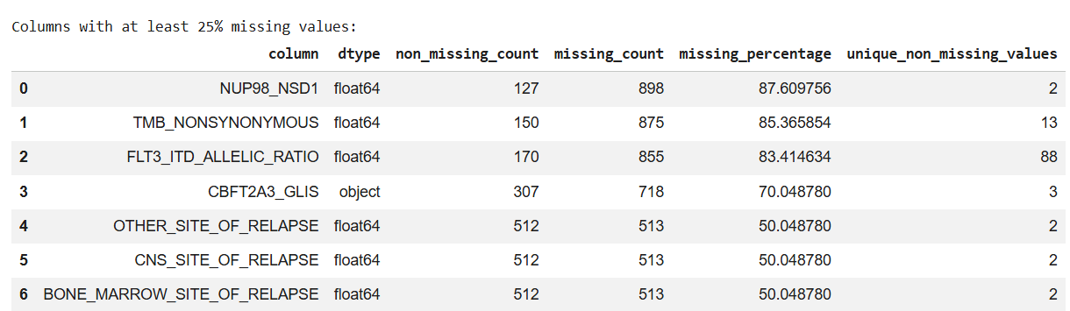
Highest missing features: Clinical Sample (>=25%)
These columns were excluded except FLT3_ITD_ALLELIC_RATIO before data imputation step

Slide 6
Clinical Sample Simplification: How to choose which sample to use?
All samples of one patient
Diagnostic sample available?
yes
no
Keep diagnostic samples
Review metadata or exclude patient
Bone marrow sample (09) available?
no
Blood sample (03) available?
yes
no
yes
use 03
use 04, otherwise another sample
use the 09 sample
one sample per patient

Slide 7
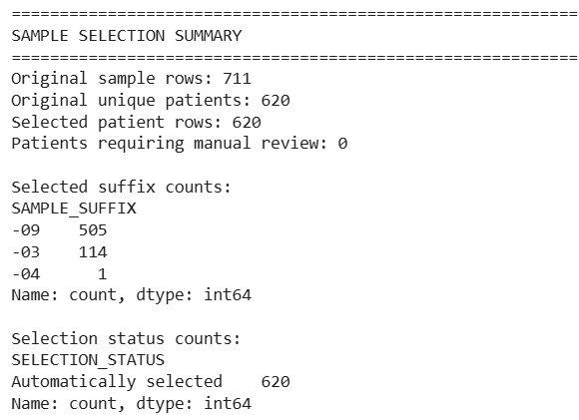

Train set
Most selected samples are bone marrow diagnostic samples (-09), indicating that the sample selection strategy successfully prioritized the biologically preferred specimen type.

Slide 8
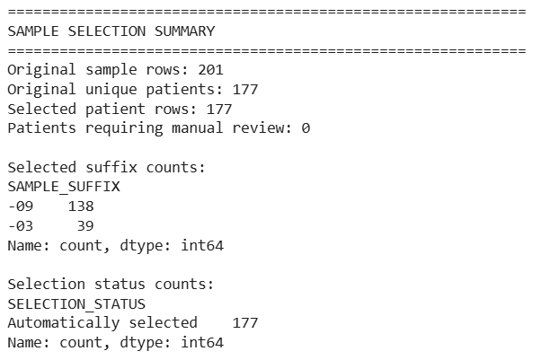

Validation Set

Slide 9
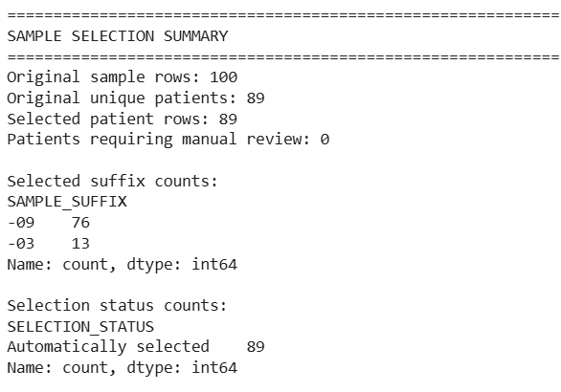

Test Set

Slide 10
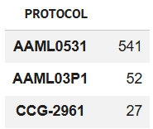
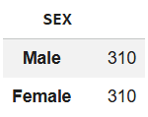
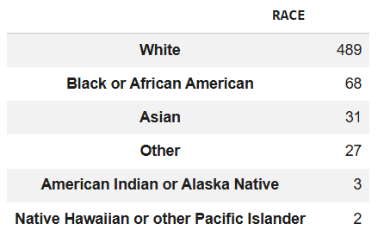
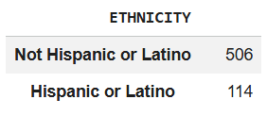
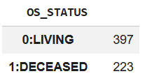
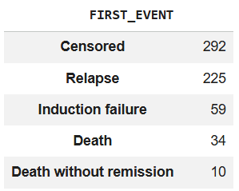
Exploratory Data analysis (EDA) on Clinical Patient (train set, imputed)
Property | Value
Number of patients | 620
Number of columns | 22
Remaining missing values | 23 (risk group)

Slide 11
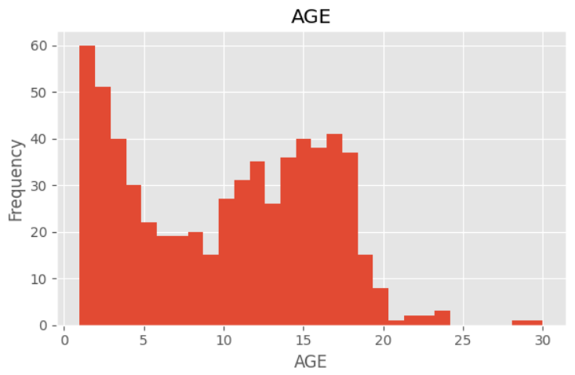
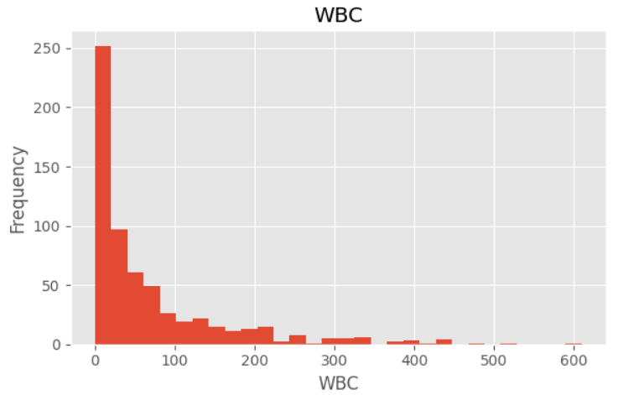
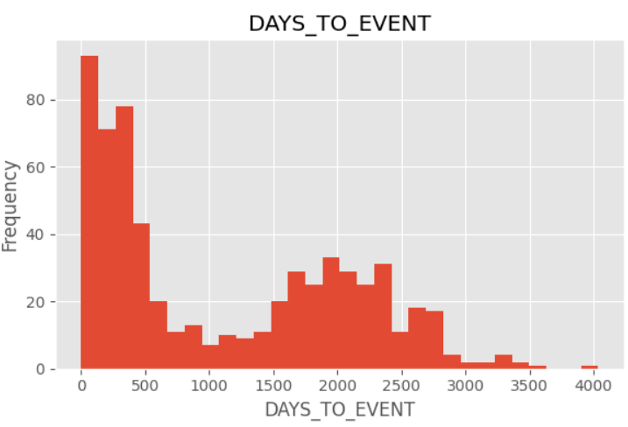
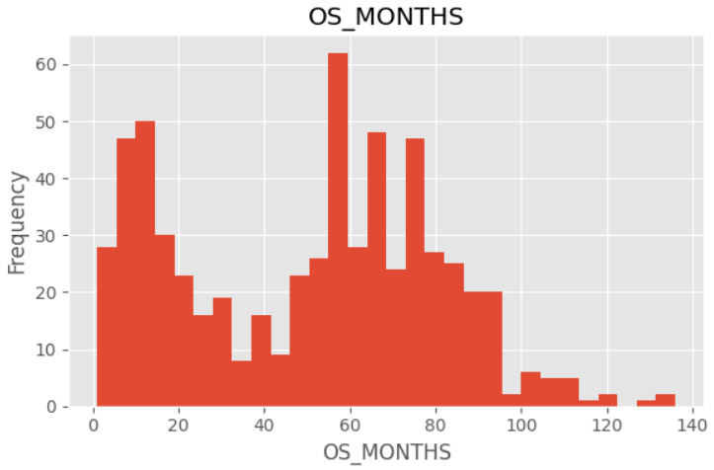
Figures

Slide 12
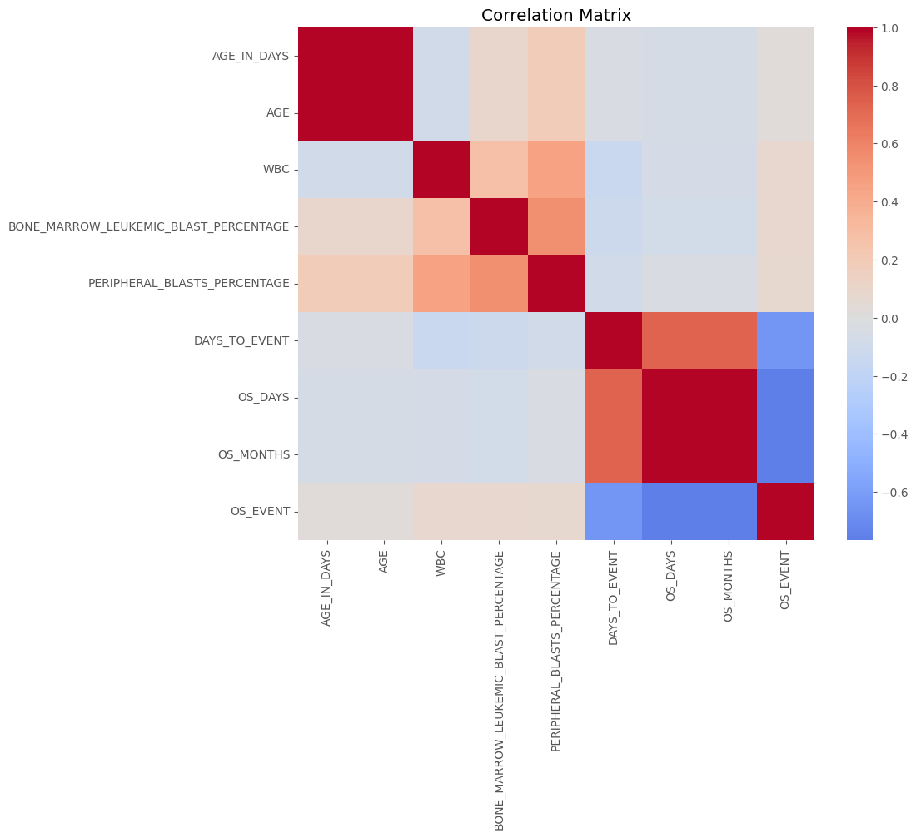

Slide 13
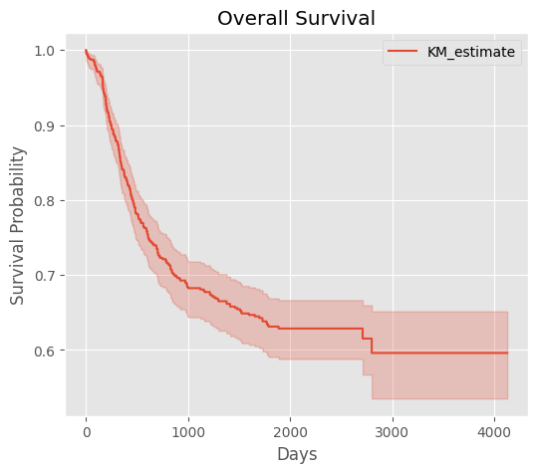
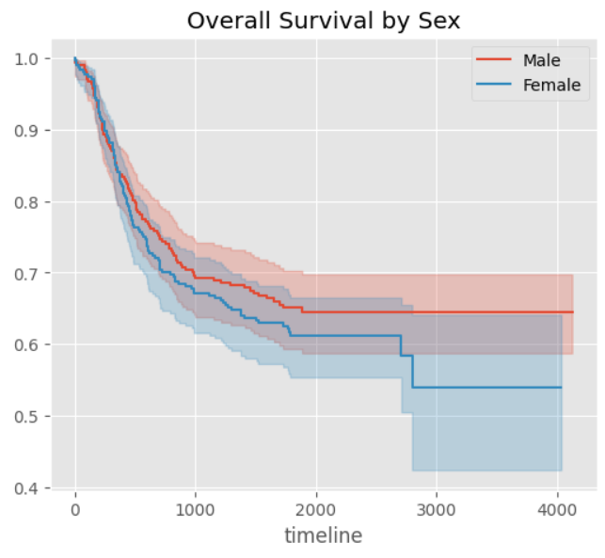
Kaplan-Meier Curves

Slide 14
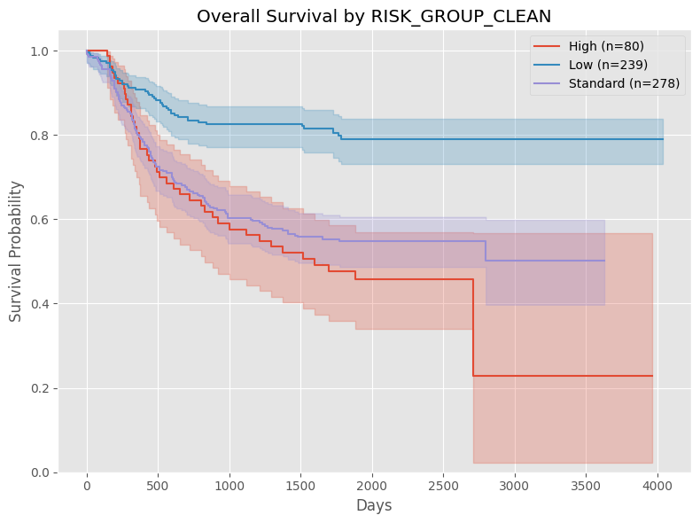

Slide 15
Exploratory Data analysis (EDA) on Clinical Patient (train set, imputed, simplified -one sample per patient-)
Property | Value
Patients | 620
Samples | 620
Variables | 32
Missing values | 0
Sample Suffix | Count
-09 | 505
-03 | 114
-04 | 1

Slide 16
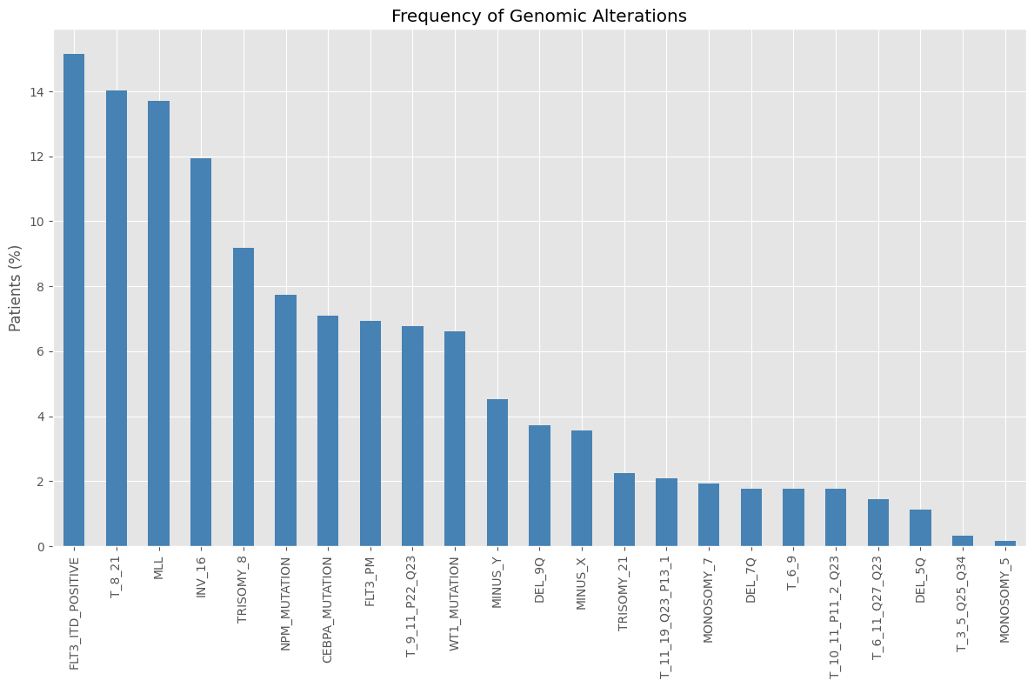

Slide 17
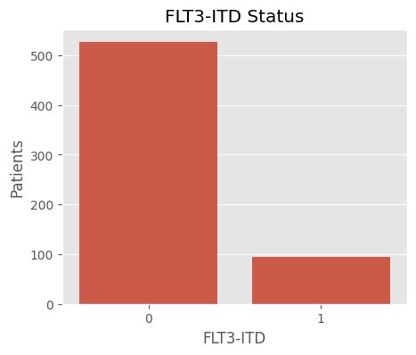
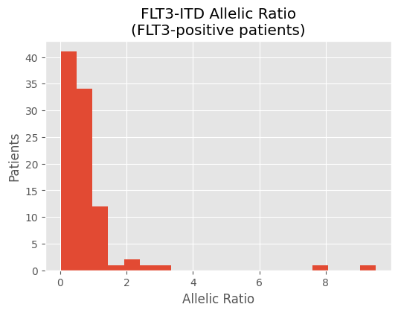

Slide 18
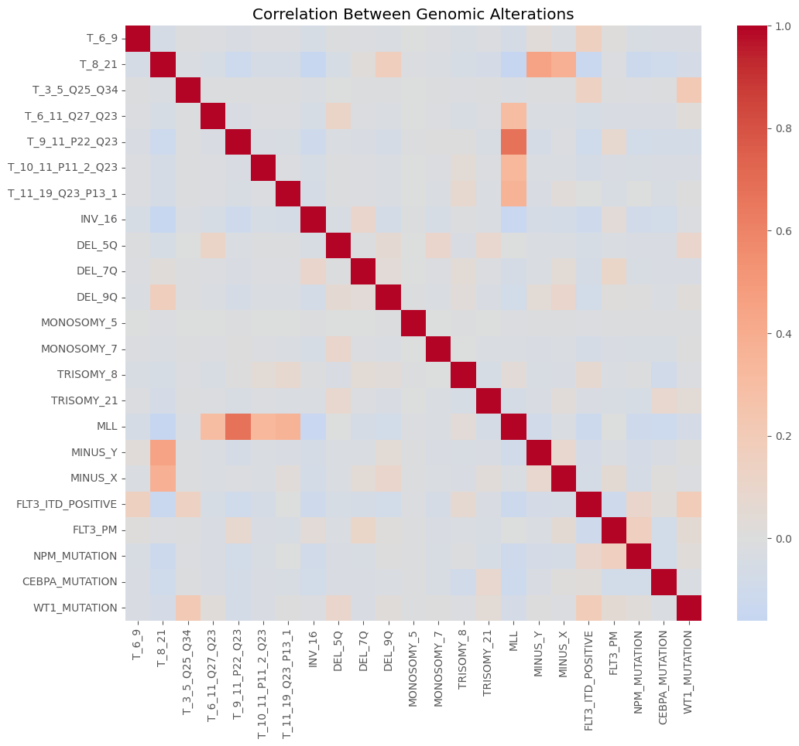

Slide 19
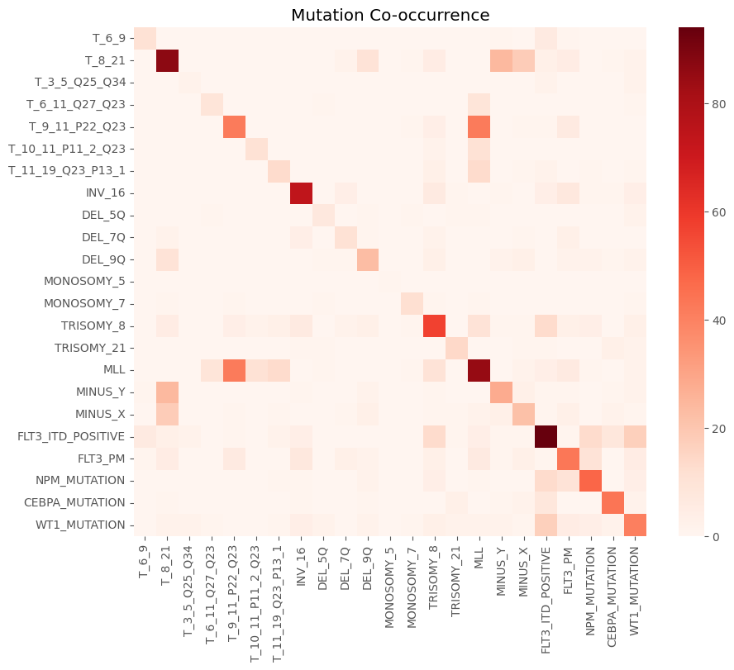

Slide 20
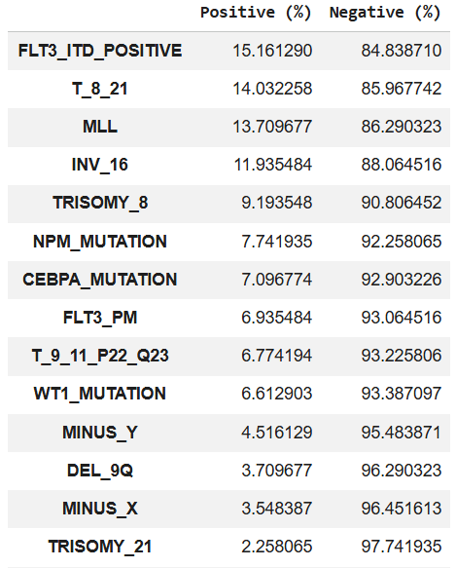
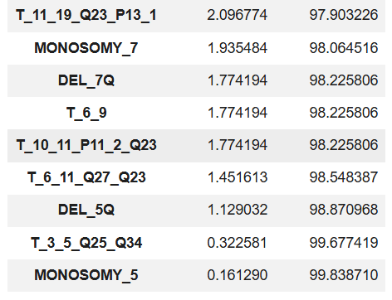

Slide 21

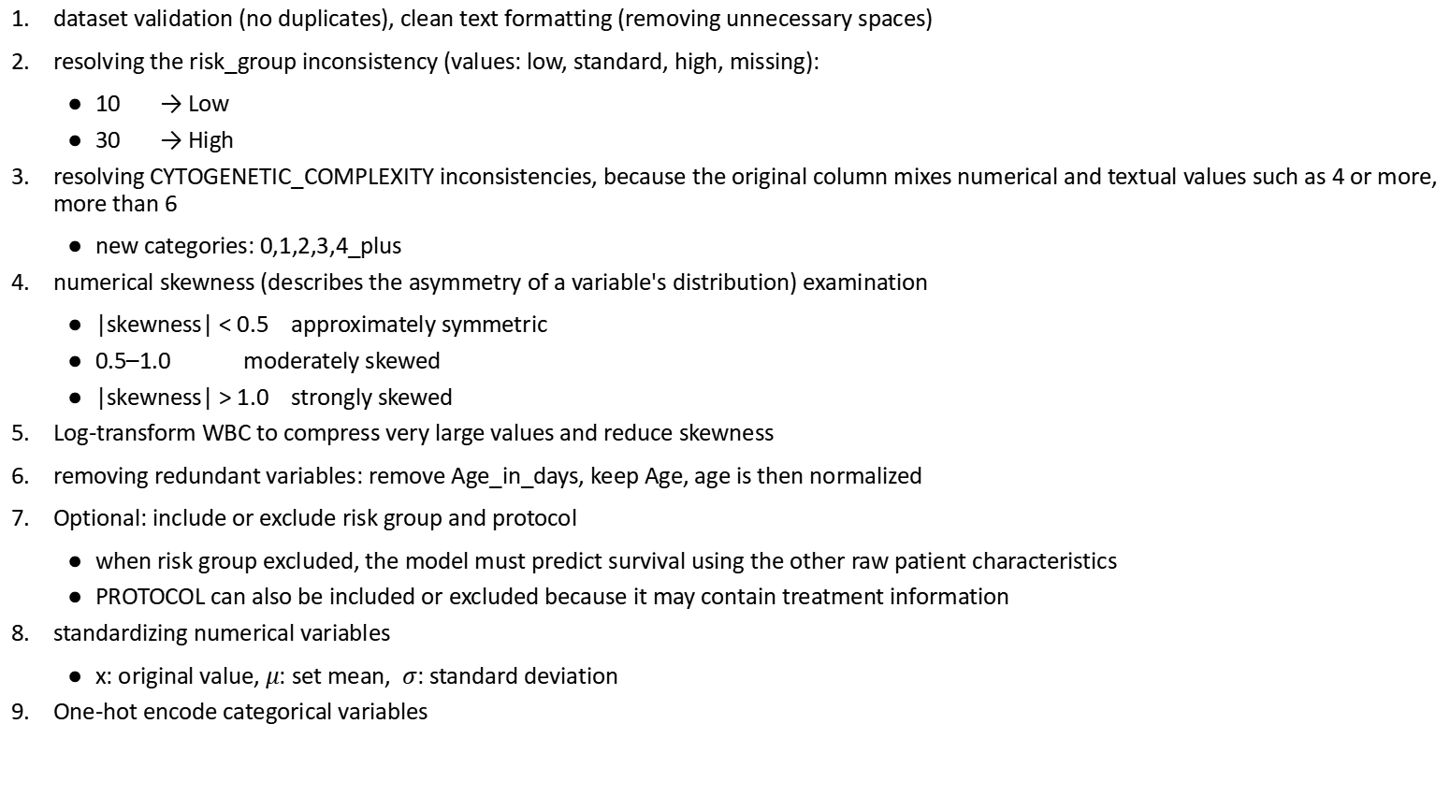
Dataset Normalization: Clinical Patient
dataset validation (no duplicates), clean text formatting (removing unnecessary spaces)
resolving the risk_group inconsistency (values: low, standard, high, missing):
10 → Low
30 → High
resolving CYTOGENETIC_COMPLEXITY inconsistencies, because the original column mixes numerical and textual values such as 4 or more, more than 6
new categories: 0,1,2,3,4_plus
numerical skewness (describes the asymmetry of a variable's distribution) examination
|skewness| < 0.5 approximately symmetric
0.5–1.0 moderately skewed
|skewness| > 1.0 strongly skewed
Log-transform WBC to compress very large values and reduce skewness
removing redundant variables: remove Age_in_days, keep Age, age is then normalized
Optional: include or exclude risk group and protocol
when risk group excluded, the model must predict survival using the other raw patient characteristics
PROTOCOL can also be included or excluded because it may contain treatment information
standardizing numerical variables
x: original value, $μ$: set mean, $σ$: standard deviation
One-hot encode categorical variables
Cytogenetic Complexity
0 → 0
1 → 1
2 → 2
3 → 3
4 → 4_plus
5 → 4_plus
6 → 4_plus
10 → 4_plus
4 or more → 4_plus
More than 6 → 4_plus
WBC: strongly right skewed
z$=\frac{x−μtrain}{σtrain}$

Slide 22
Protocol information
Protocol may reflect:
treatment assignment
study period
hospital-specific practice
eligibility criteria
differences between clinical cohorts
Protocol information was excluded because it can reduce generalizability to:
another hospital
another treatment era
another protocol
future patients receiving newer treatment

Slide 23
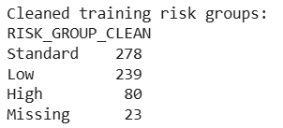
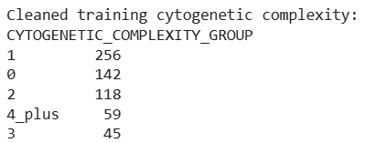
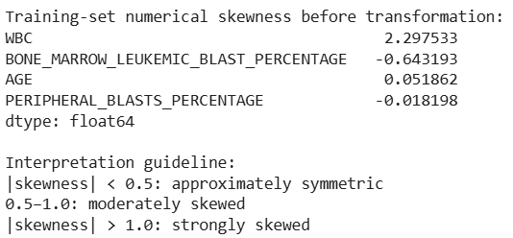

Outputs of the normalization: survival_ready splits

Slide 24
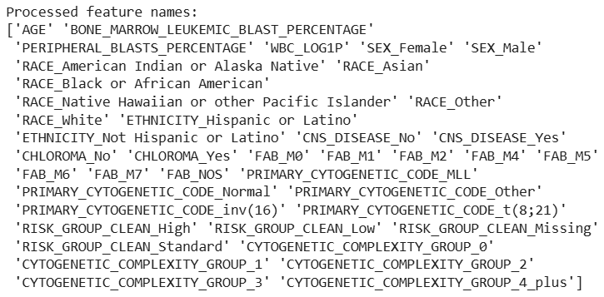

Slide 25
Dataset Normalization: Clinical Sample
validating patient IDs and columns
removing non-informative metadata from´predictors (input columns to predict survival)
preserves binary genomic variables as 0/1
log-transforms and standardizing FLT3 allelic ratio→because highly right-skewed

Slide 26


Slide 27
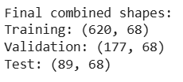
Merged dataset
clinical patient + clinical sample
All three (train,test,val) combined datasets have identical column names and column order.

